Slide 1




Yarn Supply Chain Management

Slide 2





The textile company faces transportation challenges due to the lack of an analytical and computational approach in their current policy. This leads to inefficiency, increased costs, and longer transportation times. To address this issue, the company aims to implement a new policy that optimizes transportation for improved efficiency and cost savings. Furthermore, accurate sales forecasting is crucial for effective inventory management and maximizing profitability in the highly competitive textile industry. The company seeks to make informed decisions regarding production levels, inventory management, and marketing strategies. Additionally, they are considering the potential expansion of their units in Baddi, Himachal Pradesh, and Guna, Madhya Pradesh in the future.
Problem Description

Slide 3







Solution Methodology
The following diagram depicts the five steps of this research:
1
Data Pre-Processing
2
Transportation Problem
3
Forecasting of Sales
4
Results and Conclusion

Slide 4
Transportation
Problem

Slide 5


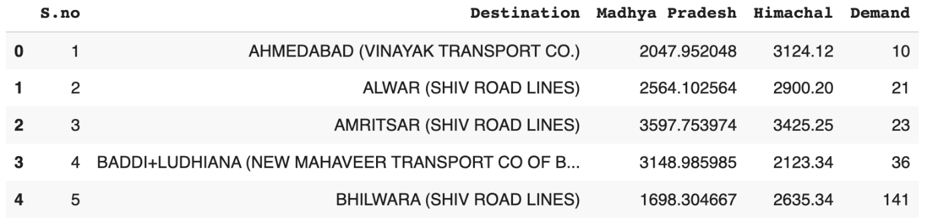
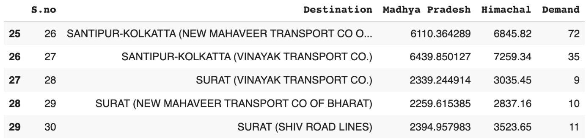

Data Collection
The data for the transportation problem collected on a monthly basis for a total of 29 destinations. The demand data of each destination corresponding to the supply of the two branches of the company and their relative cost were collected.
Data . Head( )
Data . Tail ( )

Slide 6


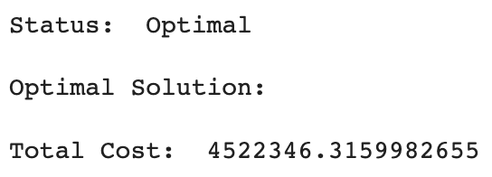

Optimal Solution
In the transportation problem, we use lists and dictionaries to represent the data. We create a PuLP problem object to minimize costs. Decision variables, objective function, and constraints are defined. The prob.solve() function finds the optimal solution. This approach optimizes transportation costs while meeting supply and demand requirements.

Slide 7
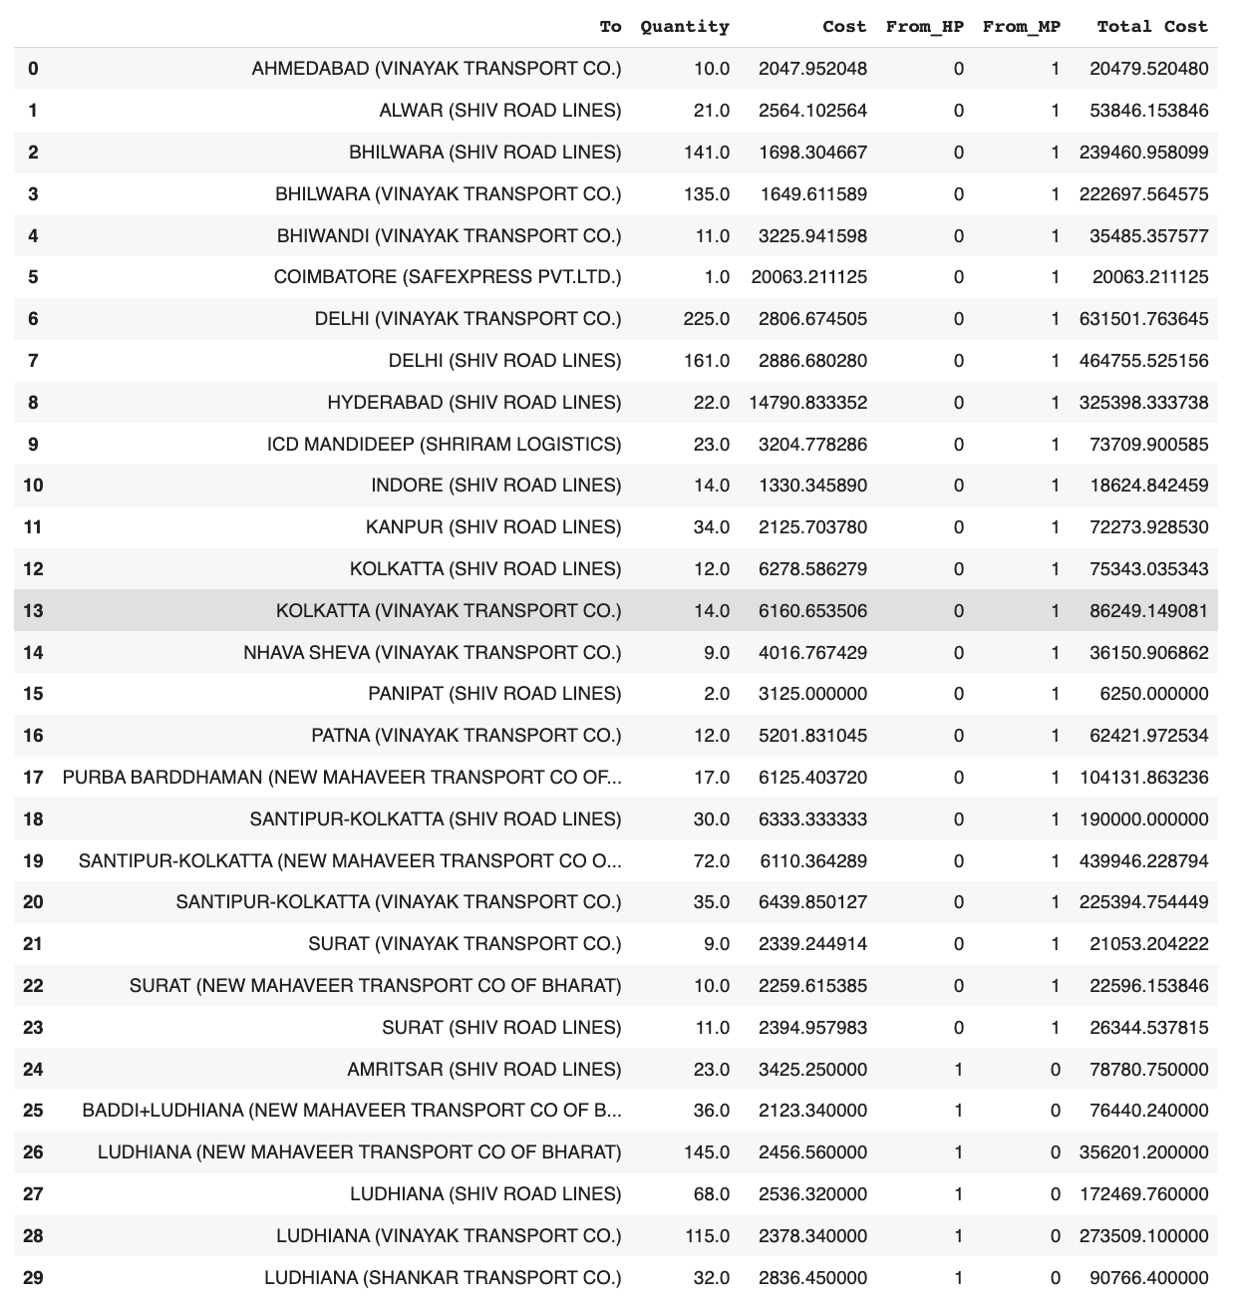
Optimal Shipping Routes
After finding the optimal solution, we print out the optimal shipping routes along with their corresponding cost:

Slide 8
Sensitivity Analysis
We perform sensitivity analysis by looping through each constraint and variable in the problem. For each constraint, we gather information such as its shadow price, slack value, and allowable changes in the objective function coefficient to maintain feasibility. Similarly, for each variable, we collect details like its current value, reduced cost, and allowable adjustments to ensure feasibility. These sensitivity analysis results are stored in a list and converted into a Pandas dataframe for easy interpretation. The resulting dataframe showcases the key sensitivity metrics, aiding in decision-making.

Slide 9
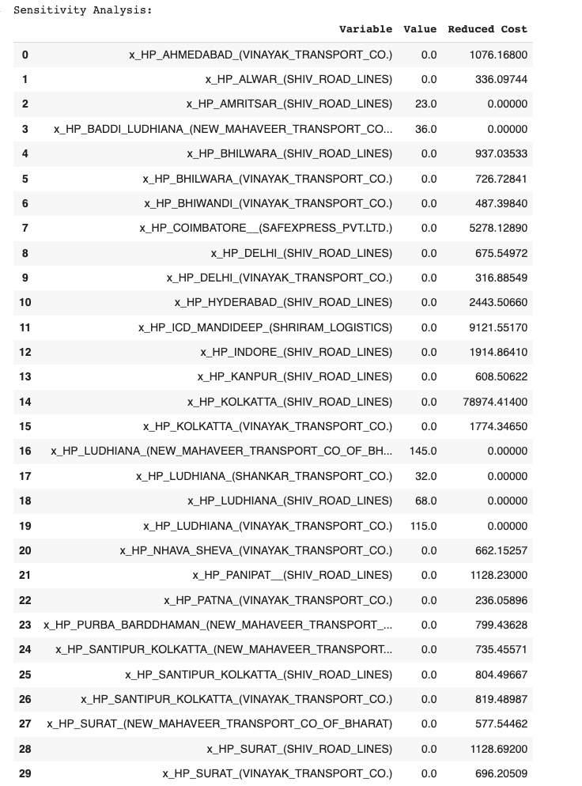
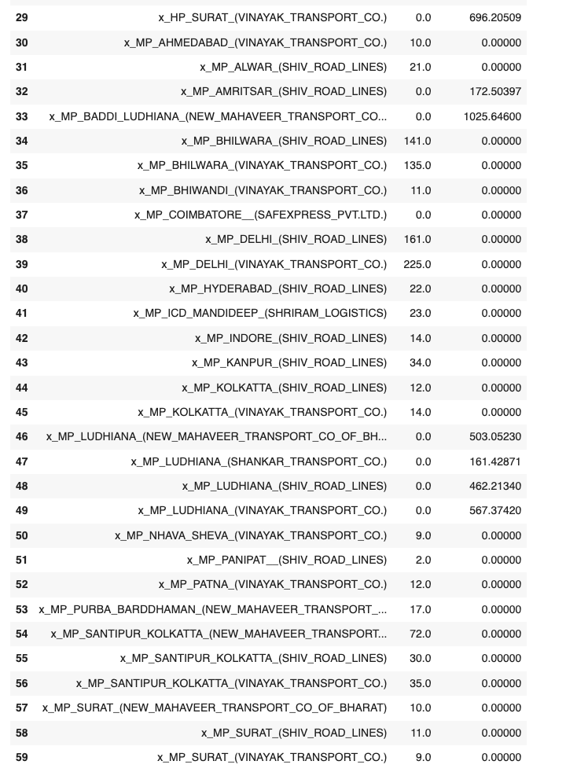
Following is the result of the sensitivity analysis performed:

Slide 10
Result Analysis
The ‘value’ column in the output of sensitivity analysis represents the current value of the decision variable in the optimal solution of the linear programming problem.
The ‘reduced cost’ column refers to the amount by which the objective function coefficient of a non-basic variable would have to improve in order for that variable to enter the basis and become a basic variable.
Since the above obtained solution has a positive value for the reduced cost or is zero, this implies that the variable is already at its optimal value and it cannot be included to make the results better.

Slide 11
Sales Forecast

Slide 12
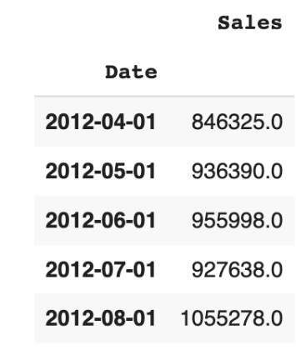
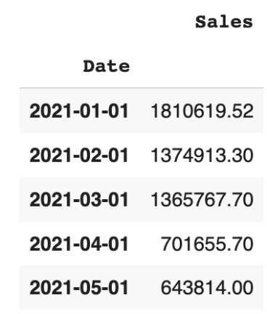
Data Collection
The monthly data for the supply forecasting was collected from April 2019 to March 2023 and it was consolidated into a single spreadsheet file. It consisted of month-wise distribution of the sales of the company’s highest produced thread- NE 1/18 PO SG 54/55/56 (Polyester) in Guna along with their month-wise total.
Train . Head( )
Test . Head( )

Slide 13
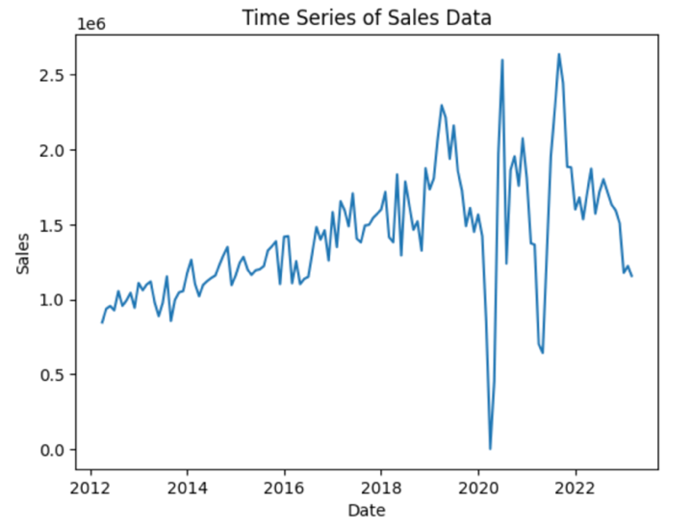
Data Visualization
Data visualisation is the most crucial step in forecasting as it presents us with the insights withing the data to better understand it and make sense out of it by observing patterns and trend. We observe the characteristics of the data by plotting the time series of the original data.

Slide 14
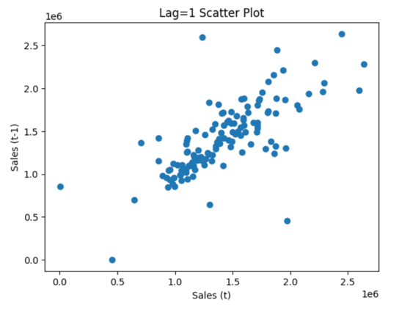
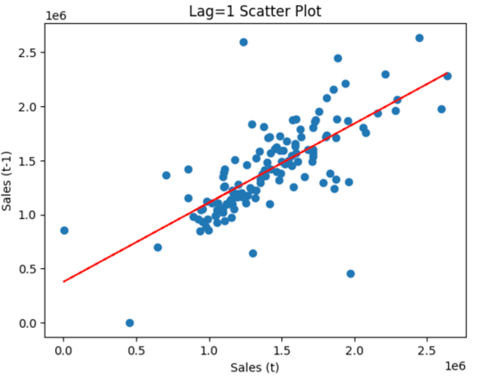
Data Visualization
Time series modelling assumes a relationship between an observation and the previous observation. Previous observations in a time series are called lags. A useful type of plot to explore the relationship between each observation and a lag is presented. Here, Lag of 1 time period is plotted against the previous observations showing a relatively strong dependence between the two.
Another possibility for better capturing the shape of the trend is to add a trend line. By trying different trend lines we came up with linear trend line to be best fit, as it best approximates the data.
Lag=1 scatter plot
Fitting trend line

Slide 15
Model Applied along with their RMSE
We try to forecast the sales using several models. The name of the models applied along with their corresponding RMSE vale is stated in the table given below:
Models | RMSE
Moving Average | 504716.38
Exponential Smoothing | 581789.99
ARIMA | 516872.08
SARIMA | 446817.24
LSTM | 1672664.04
Based on the above table we conclude that SARIMA is the best choice of model to be implemented for the sales forecasting.

Slide 16
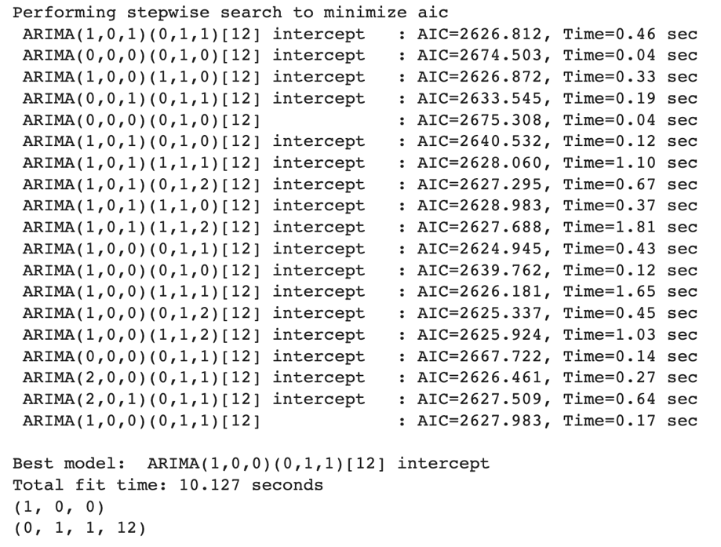
SARIMA Model
We perform a grid search to determine the optimal hyperparameters for a SARIMA model. The selected hyperparameters for the SARIMA model obtained through the grid search are printed. It reveals the optimal order values for the non-seasonal components (AR, I, MA) and the seasonal components (SAR, SI, SMA, m), highlighting the crucial parameter selection process for accurate time series forecasting.

Slide 17
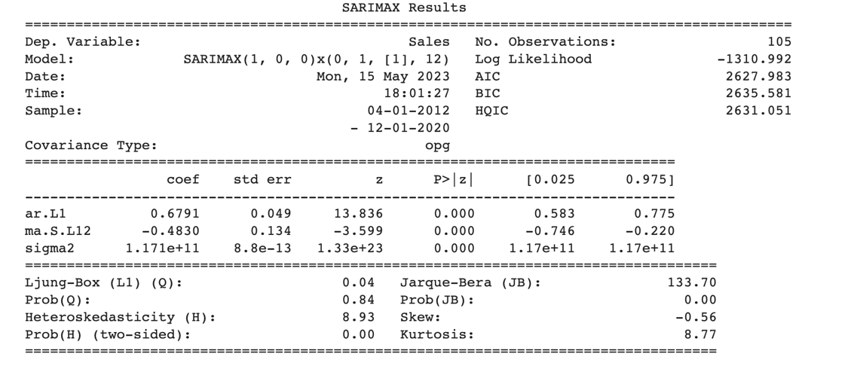
SARIMA Model
A SARIMAX model is instantiated with the training dataset, using the optimal order values for the non-seasonal components (AR, I, MA) and the seasonal components (SAR, SI, SMA, m) identified through the grid search. The model is then fitted to the training data, and the fitting results are printed as a summary. This summary provides detailed statistical information about the fitted SARIMA model:

Slide 18

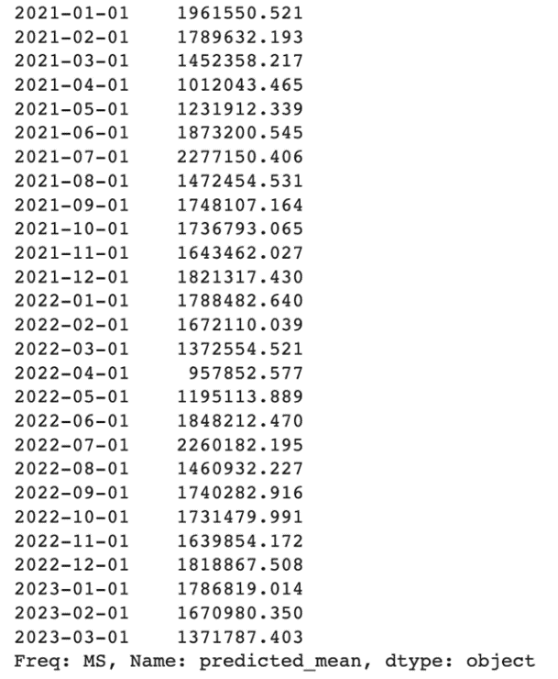

The SARIMA model is used to obtain forecasts on the test set. The predictions on the test data is as follows:
Next, we calculate the root mean squared error (RMSE) between the actual values in the test set and the predicted values generated by the SARIMA model.

Slide 19
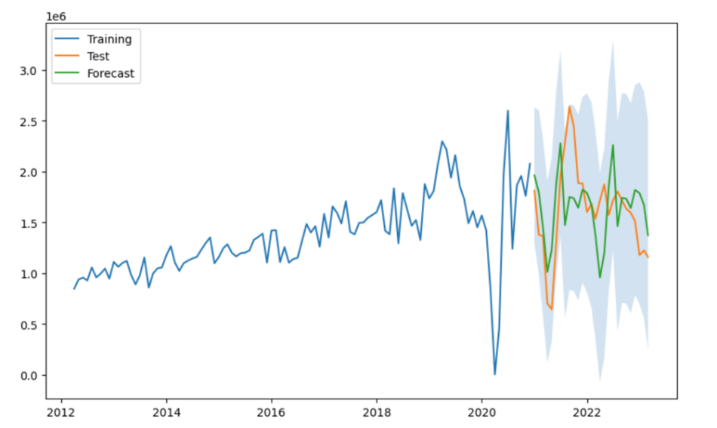
Plotting
To visualize the time series data, we plot the actual, test, and predicted values. The training and test data are shown as line plots, while the predicted values are displayed separately. Confidence intervals are indicated by a shaded area.

Slide 20
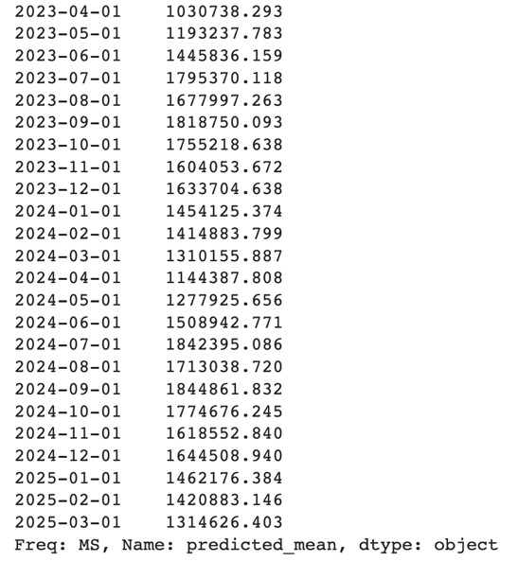
Future Forecast
The SARIMAX model is fitted to the monthly dataset using selected hyperparameters and the future forecasts are generated.

Slide 21
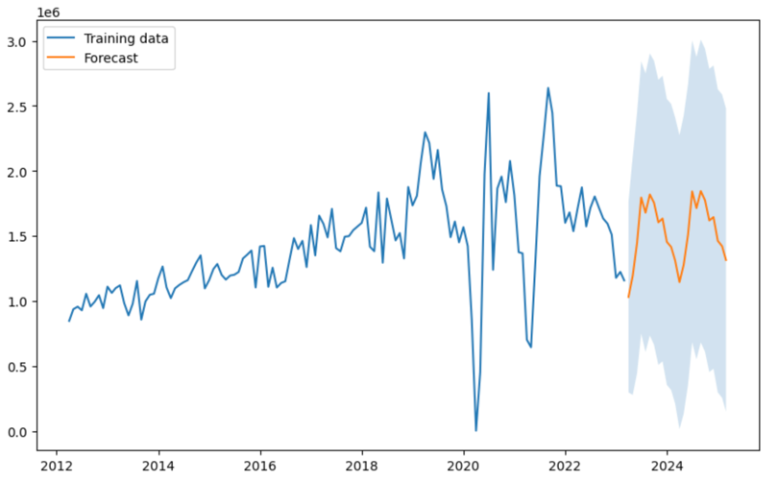
Future Plotting
To visualize the results, the training data is plotted, and the forecasted values obtained from the SARIMA model are overlaid on the plot. A shaded area representing the confidence intervals is added as well. Finally, the plot is displayed to present the findings effectively.

Slide 22

Comparison between the Transportation Costs
Comparison between the transportation costs
Old Transportation Cost: Rs. 5141000.0 (As per given by the company)
Optimized Transportation Cost: Rs. 4502283.10
The implementation of optimized transportation routes has resulted in significant cost savings for the company. By switching to the optimized routes, the company can now save up to Rs. 638716.90 that were previously being spent on transportation.

Slide 23
Conclusion and Policy

Slide 24
Conclusion
From the optimal shipping routes, it can be observed that the preferrable transportation source is Guna, Madhya Pradesh due to its proximity to most of the destinations.
Therefore, based on these results we try to determine whether the company can expand their unit in Guna by analyzing their sales. By forecasting the future sales, we observe a consistent result in the future as well.
Recommended Policy
Therefore, considering the above concluded factors we formulate a policy to be recommended:
Through the optimization of shipping routes, significant cost savings can be achieved by the company, enabling the allocation of freed-up funds towards various other expenditures. Additionally, taking into consideration the boom in the future of the textile industry, the company can consider setting up their new units in Guna, Madhya Pradesh.

Slide 25
Thank You

